Slide 1
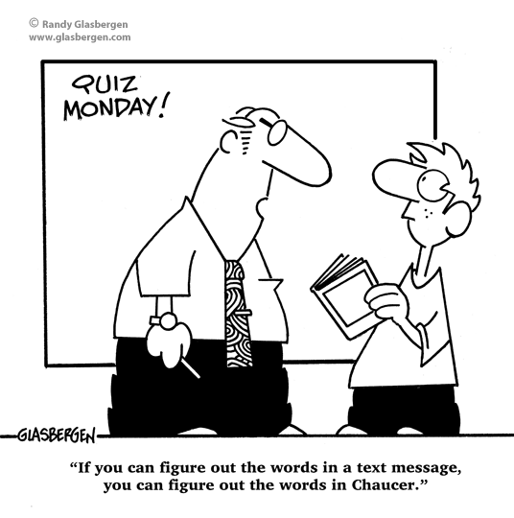
The Reading Tool Kit – Essential strategies for Years 3 – 6
Presented by Jane Caughey, Dip.T., B.Ed. & Grad.Dip.Ed.

Slide 2
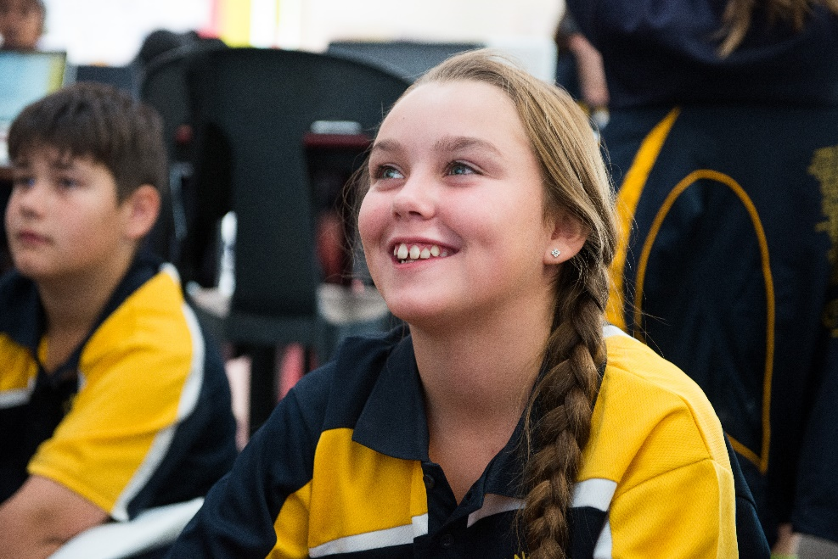
In this webinar, we will explore how to help your students develop self-monitoring behaviours using the following reading strategies:
self-correcting
cross checking
predicting and confirming
re-reading
skimming and scanning

Slide 3
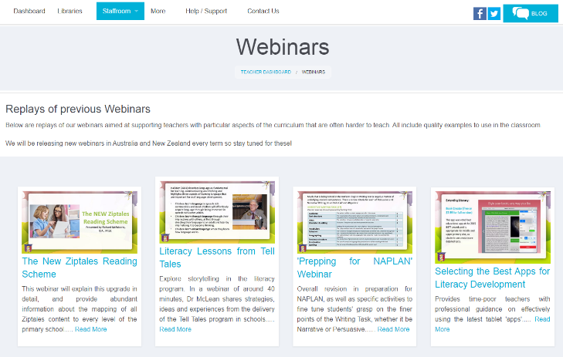
Ziptales offers two webinars specifically targeting this area. They are:
Building Inferential Comprehension Skills (Years 3 – 6)
Exploring Subtext (Years 5 & 6)
These webinars can be located via the Webinars link in the Staffroom section of the Teacher Dashboard.

Slide 4
Curriculum Links for Reading Strategies:
The Australian Curriculum:
Read different types of texts by combining contextual, semantic, grammatical and phonic knowledge, using and applying text processing strategies, for example, monitoring meaning, cross checking, predicting and confirming, rereading, reading on, self-correcting, reviewing, skimming and scanning
(Literacy Strand: Interpreting, Analysing, Evaluating)

Slide 5
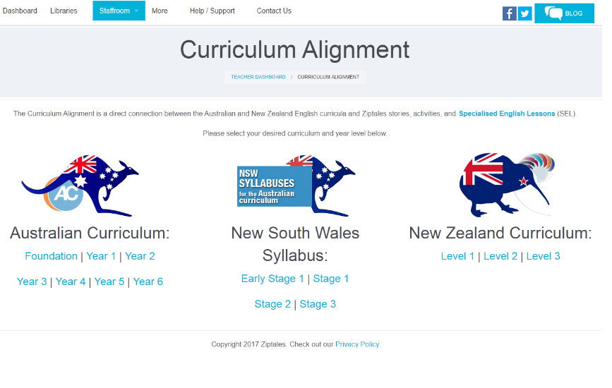
The New Zealand Curriculum:
select, use and integrate sources of information (meaning, structure, visual and grapho-phonic information) to make sense of increasingly varied and complex texts;
use an increasing knowledge of letter clusters, affixes, roots, and compound words to confirm predictions;
(Listening, Reading, Viewing:
Processes and Strategies and
Language Features)

Slide 6
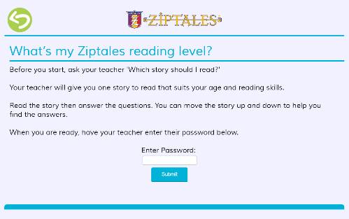
Ziptales has recently added a Reading Engine feature that directs your students to a list of titles that are suited to their reading abilities.
A webinar explaining this new scheme is available on the Ziptales home page entitled New Reading Scheme and your students can access the Reading Engine via the Student Home Page link What’s My Ziptales Reading Level?

Slide 7
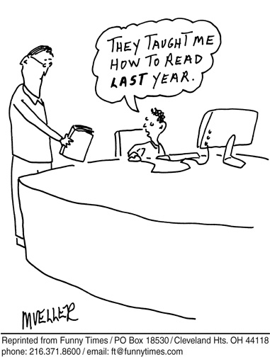
Self-correcting
Self-correcting is a skill usually taught in the early primary years. However it is imperative that it is reinforced in the middle-upper primary years. Self-correcting empowers the reader to take ownership of their reading, ensuring that the meaning of the text is not lost.

Slide 8
Activities:
Discuss with students the purpose of self-correction. Encourage them to use an internal dialogue whilst reading e.g. That didn’t sound right, I’ll go back and try it again.
Use popular tongue twisters or spoonerisms as a fun way of promoting the self-correcting strategy. For example, rewrite the excerpt of the spoonerism passage from Prinderella and the Since from the Yrs 3 & 4 Specialised English Lessons Reading Module Nonsense Devices.

Slide 9
Students read through the pre-filled Fill the Gaps activity at the end of the Reading Library and Advanced Library genre stories before entering the correct answers. Then they correct the errors and count how many mistakes were present during the first reading.
Provide opportunities for students to record themselves reading one or more pages of a Ziptales story as recommended by the Reading Engine. Playback their reading with a teacher or classmate and make notes of any reading errors. They then reread the story, recording it again identifying how many errors were corrected in the second reading.
View the Specialised English Lessons Reading Module Reading Skills (Yrs 5 & 6) to encourage students to use self-correction and other strategies to assist with monitoring their understanding of what they’re reading.

Slide 10
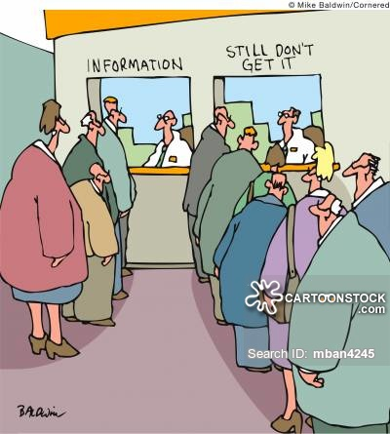
Cross-checking
The cross checking strategy means being able to use a combination of phonics knowledge, high frequency word recognition and context clues to decode unknown words in order to better understand a text.
Using phonic knowledge
Building phonics knowledge is crucial.
This includes recognition of the phonemes used for individual letters and letter clusters and using syllabification and segmentation to break up longer words.

Slide 11
Activities:
Create a ‘Syllable Chart’ that classifies words from the Reading Library Spelling and Vocabulary worksheets according to their number of syllables. Discuss with students how breaking longer words into syllables can help them read the word e.g. Vocabulary from the Mystery story The Attic:
Write words from the Reading Library Spelling and Vocabulary worksheets as Syllable Sums where the word is separated according to its syllables. For example: words from the Animal story Princess Nightmare:
friend+ship = friendship
dis+gust+ing = disgusting
1 syllable | 2 syllables | 3 syllables | 4 syllables | 5 syllables
weird | liquid | fairytale | cemetery | curiosity
 | favourite | forbidden | mysterious | experimenting
 | destroyed | scientist |  | possibilities

Slide 12
View the Specialised English Lessons Reading Module Developing Reading Skills (Yrs 3 & 4) and use the activities to improve students’ recognition of consonant blends, diphthongs and base words to assist with word identification strategies.
Study the following Spelling modules in Skill Builders and use the associated worksheets to assist students with reading unfamiliar words:
#4 – Base words
#8 – The different pronunciations of c and g
#18, #19 & #20 – Consonant blends etc
#23, # 24 & #25 – Tricky clusters e.g. air, are, ear, etc
#26 & #27 – Silent letters
#29 – Odd spellings

Slide 13
Students locate 5 - 10 potentially difficult words from a focus text before they read it and create a ‘Phonemic Clues’ chart. For example: words from the Fantasy story The Bravest Knight:
Word | Phonemic (Letter/Sound) Clues
knight | Silent ‘k’ and ‘gh’, long ‘i’ sound
sign | Silent ‘g’, long ‘i’
stomach | ‘o’ makes short ‘u’ sound; ‘ach’ makes ‘ick’ sound
caught | ‘au’ makes ‘or’ sound; ‘gh’ is silent
wondered | ‘o’ makes a short ‘u’ sound; ‘ed’ just makes ‘d’

Slide 14
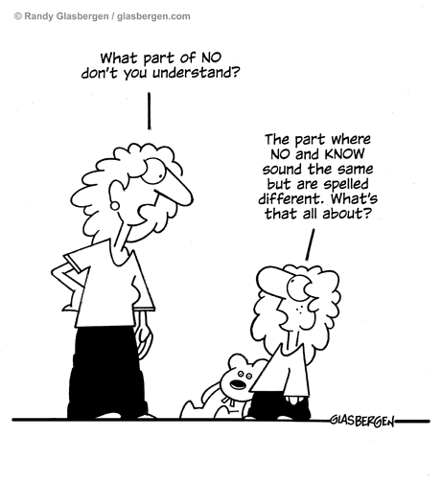
Recognising high frequency words
Older students should continue to be exposed to more difficult commonly used words and be aware that many high-frequency words can be homophonous in that they sound the same but are spelt differently.

Slide 15
Activities:
Locate high frequency word lists appropriate for the reading ability of your students e.g. Fry’s 1000 Instant Words. Students create a Bingo card using selected words from the list. Every time they read a new focus text, they scan through the text after they have finished reading and mark off words from the story on their Bingo card. Once their Bingo card is completed, they create a new card with a different set of words.
Students view the Skill Builders Spelling Module #28 Homophones and complete the associated worksheets to explore the most commonly used homophones e.g. there, their and they’re.

Slide 16
Use the Reading Library or Advanced Library genre stories for students to conduct a ‘Homophone Hunt’. Once they have finished reading the story, they scan back through the text writing down all the words that have a matching homophone e.g. Lost in the Rainforest (Adventure)
Homophone Hunt Name of Story: Lost in the Rainforest
Word from the story | Matching homophone(s)
there | their, they’re
see | sea
no | know
sight | site
so | sew

Slide 17
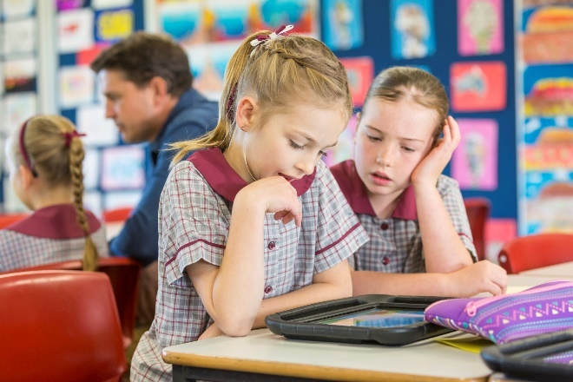
Using Context Clues
Context clues can be very helpful for students attempting to decode unknown words.
The two main types of context clues appropriate for this age level are semantic (meaning) clues and syntactic (or grammatical) clues.

Slide 18
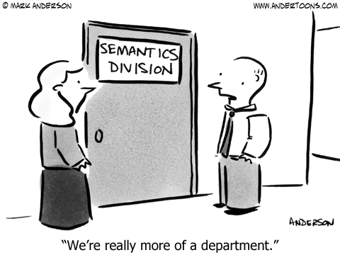
Semantic Clues
Semantic clues are clues associated with a word’s meaning and can be found in the same sentence and/or the surrounding sentences.
The student is required to focus on how the word is used in the text. For example, an unfamiliar word starting with the letters ast could be astronaut, astral, astronomy or asteroid but when used in the sentence: An ast.. is a solid object that orbits the sun - the reader could use context clues such as the words ‘solid object’ and ‘orbit the sun’ to help them to help them decode the word as asteroid.

Slide 19
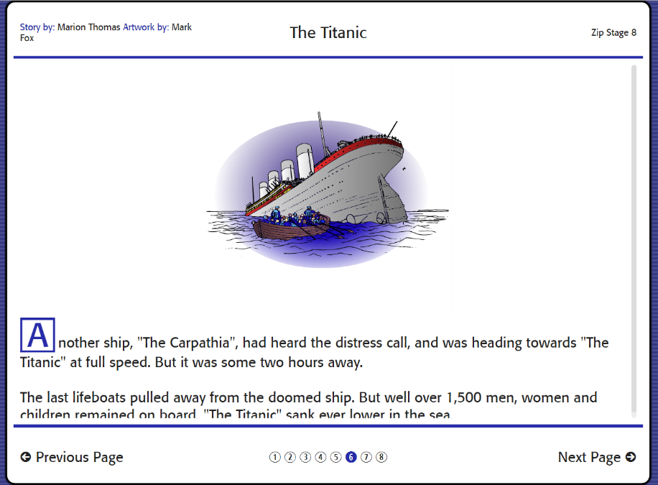
Activities:
Study the different types of semantic clues that can help identify an unknown word in a text such as the word’s meaning, synonyms, antonyms and/or the surrounding text. Create a chart for students to record this information. For example, this sentence from the True Tales story The Titanic: The ship’s designer, who was on board that night, was convinced that it was not only the greatest vessel afloat, but that it was indestructible. Record the semantic clues that could assist decode the word ‘indestructible’.

Slide 20
Semantic (Meaning) Clues
Word What is the word? | indestructible
Definition What does this word mean? | Unable to be destroyed
Synonyms What words mean the same? | unbreakable, durable, imperishable
Antonyms What words mean the opposite? | fragile, flimsy, breakable
Examples Can we find meaning clues from the other words or sentences? | The passengers were confident that they were perfectly safe It was cleverly built Unsinkable Specially designed to prevent water spreading

Slide 21
Use the Fill the Gaps activities at the end of each of the Reading Library and Advanced Library genre stories to provide opportunities for students to practise using context clues to identify an unknown word.
Distribute copies of the Glossary of Words located via the Commentary link for the Rhyme Time poems Jabberwocky, The Pied Piper of Hamelin and The Lady of Shalott for students to become familiar with the difficult words used in the poems.
Study the Spelling and Vocabulary worksheets for the Reading Library genre stories before reading a focus text for students to become familiar with potentially difficult words they may encounter in the text.

Slide 22
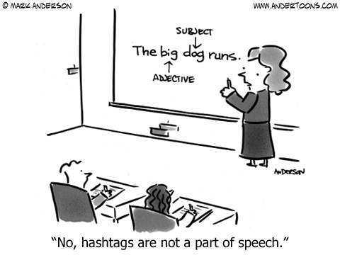
Syntactic Clues
In order to use syntactic clues, a reader is required to employ grammatical knowledge to assist them with identifying an unknown word.
For example, in the sentence – Suddenly the plane sh_______ violently, the missing word must be a verb like shuddered as a noun like shadow or an adjective like shallow wouldn’t make sense.

Slide 23
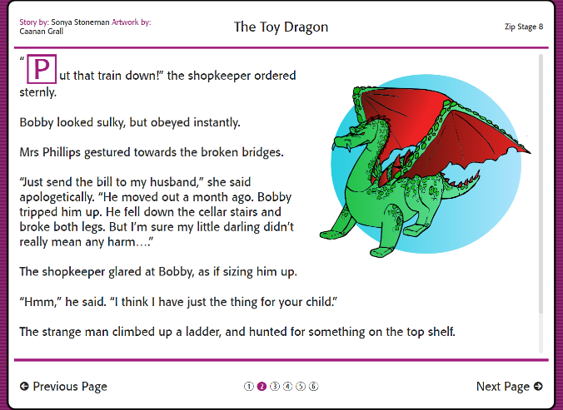
Prefixes and suffixes also provide insight into a word’s syntactic function within a text. For example, prefixes such as im, dis and mis can make the word they precede mean the opposite such as the words impossible, disobeyed and misshapen from the Reading Library Scary story The Toy Dragon. Suffixes such as ful and ous mean possessing or full of e.g. beautiful, virtuous, famous and faithful from the Myths and Legends story The Faithful Prince also provide syntactic clues to a word’s meaning.

Slide 24
Activities:
Classify the focus words from the Reading Library Spelling and Vocabulary worksheets. For example, the Adventure story Live Dinosaur Tour:
Shane and Lydia ___________ to sneak away while the teacher wasn’t looking.
The missing word will be a verb (decided).
Sandie spoke in a ______________ voice.
The missing word will be an adjective (friendly).
Some dinosaurs had spikes as defence against ______________.
The missing word will be a noun (predators).
Build students’ grammatical knowledge by viewing the Skill Builders Grammar Modules and the suite of lessons for Years 3 - 6 located via the Grammar filter for the Specialised English Lessons Writing Modules.
Develop students’ knowledge of common prefixes and suffixes using the Skill Builders Spelling Modules #12 What goes before and #13 What goes after and associated worksheets.

Slide 25
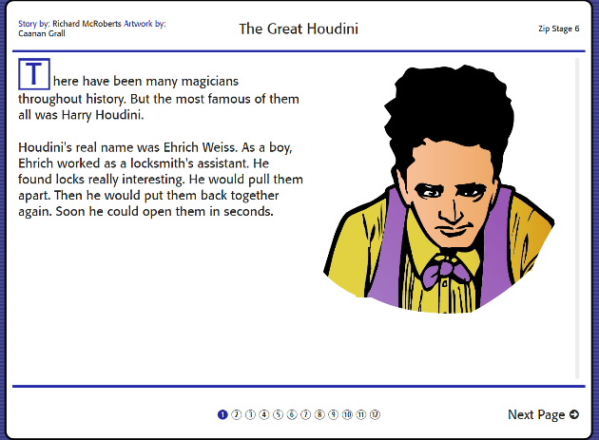
Explore how prefixes and suffixes are powerful in that they can completely change a word’s meaning in a sentence. In pairs, students separately rewrite 10 sentences from the same Reading Library or Advanced Library genre story by adding a prefix or suffix to selected words in order to change the entire meaning of the sentence. Once they have finished, they ‘swap’ their sentences and have to locate the rogue prefixes or suffixes. Here is an example from the True Tales story The Great Houdini:
There have been many magicians throughout history. But the most infamous of them all was Harry Houdini.
Here the prefix ‘in’ has been added to the word ‘famous’ completely changing the real meaning of the original sentence.

Slide 26
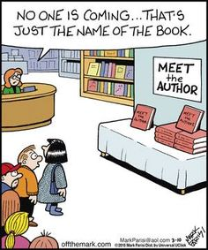
Predicting and Confirming
When readers make predictions, they are more equipped to confirm reasonable attempts at unknown words.
For example, an information text about ancient Egypt might include specialised vocabulary such as chamber, sphinx, pyramid, tomb and hieroglyphics so exposing the students to these words before attempting to read a text can assist them to make more reasonable predictions and thus confirm that their attempts are correct.

Slide 27
Activities:
Encourage students to use self-questioning techniques before and after reading a certain text by examining the cover, title and blurb e.g.
Before reading:
What type of text is this?
What do I think this text will be about?
What kinds of words might I find in this text?
After reading:
Do I understand this text?
Do I need to find out the meanings of any words I didn’t know?
Distribute copies of the Glossary of Words located via the Commentary link for the Rhyme Time poems Jabberwocky, The Pied Piper of Hamelin and The Lady of Shalott. Students work in small groups to predict how the words might be pronounced then come together as a class to confirm these predictions.

Slide 28
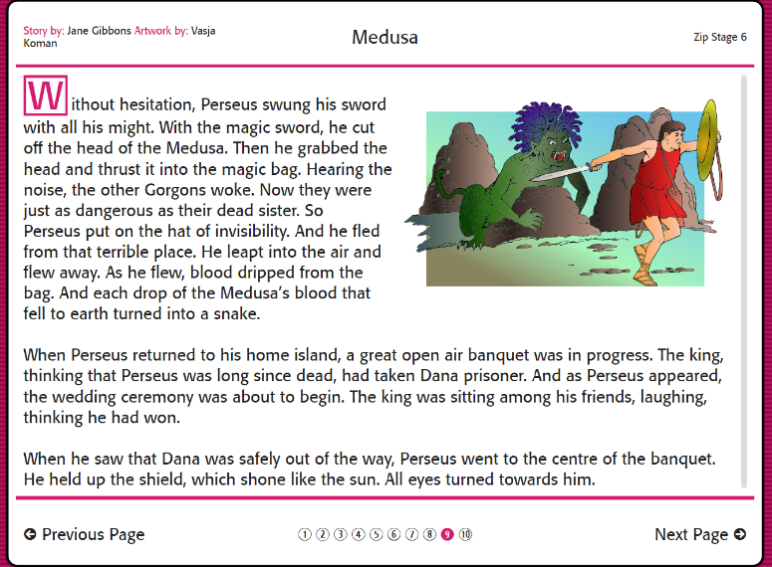
Use the word lists from the Spelling and Vocabulary worksheets for the Reading Library genre stories for students to create Vocab Grids before reading a focus text. Cut a piece of A4 paper in half then fold it to make four sections e.g. the word ‘banquet’ from the Myths and Legends story Medusa:
Word: banquet | Meaning: An elaborate and formal evening meal for a number of people
Synonyms: feast, dinner party | Sentence example: The king invited the townspeople to a banquet at the castle.
Extension: After 5-10 Vocab Grids are created, students can cut them into four separate pieces and swap them with a partner to try and recreate the original grids.

Slide 29
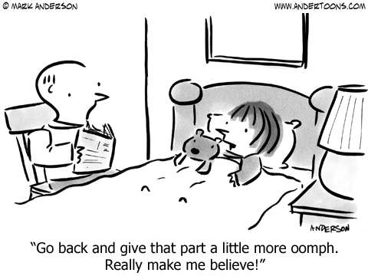
Re-reading
Re-reading is an effective text-processing strategy that helps improve a reader’s decoding, fluency and comprehension skills. This strategy can be taught and reinforced in two different ways:
Re-reading the same text repeatedly to develop fluency and expression.
Re-reading specific chunks of a text to promote or clarify understanding of the content.

Slide 30
Activities: Re-reading a text repeatedly
Provide opportunities for students to re-read a Rhyme Time poem to present to an audience using the Teacher Strategies for the The Owl and the Pussycat, Wynken, Blynken and Nod and The Pied Piper of Hamelin.
Use texts that promote re-reading opportunities such as the Choose Your Own Adventure stories where the story format requires the reader to restart the story once a particular plot sequence has ended.
Use guided reading group activities for students to practise re-reading. Students read a Reading Library or Advanced Library genre story appropriate to their reading ability using Reading Engine results. Ask each student to take turns reading the same page(s) aloud over 3-4 separate reading sessions using the associated worksheets for that story as follow up activities afterwards.

Slide 31
Activities: Re-reading for meaning
When introducing the Reading Engine to students, promote the re-reading for meaning strategy by demonstrating the sidebar feature that enables them to scroll up and down the page to re-read sections of the story to help them answer the multiple choice questions.
Use the Multiple Choice questions at the end of the Reading Library and Advanced Library genre stories to encourage students to use the re-reading for meaning strategy. Once they have answered five questions, they can select the ‘Back to Story’ link to locate the parts of the story to rectify any errors and improve their score.
Students use the re-reading for meaning strategy to assist them with completing the sequencing activities from selected Reading Library Learning Support Worksheets e.g. Dr Wow (Adventure), The Wizard’s Staff (Fantasy) and Capsize! (True Tales).

Slide 32
Choose an Advanced Library Zip Stage 9 or 10 text (eg Body Language, Computer Games) and use it as an example of a dense text - meaning rich in complex ideas, which requires reading and re-reading the text before completing the associated worksheets.
Promote the use of the re-reading for meaning strategy using the following worksheets for the Children in History photo stories – The Bell and the Bushrangers #1 and The Secret Journey #1 & #3.

Slide 33
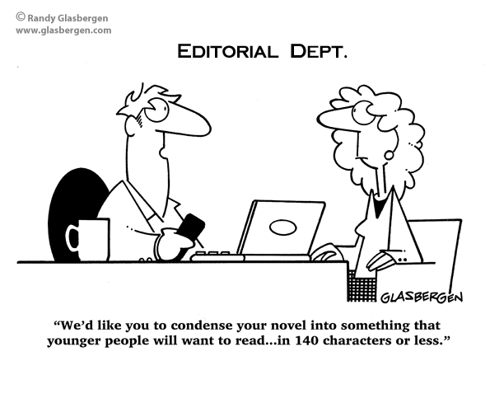
Skimming and Scanning
Skimming and scanning requires readers to move their eyes quickly over a text to pinpoint specific words and phrases.

Slide 34
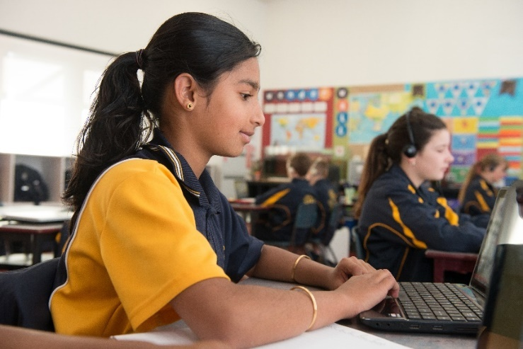
Skimming is a strategy used to gain a general idea of the structure and content of a text such as finding main ideas in information texts and determining if a text is suitable for research needs.
Scanning involves identifying more specific details within a text to confirm understandings about the content of the text. Note taking and paraphrasing are often used to assist with this process.

Slide 35
Activities:
Use the Skill Builders or Write Time information modules. Use the following questions to explain how skimming over the words gives us idea about what information is contained in the text:
What type of text is this?
Why would someone read or view this text?
What kind of information would be found in this text?
Students read or view a selected Skill Builders or Write Time digital documentary and practise the skimming strategy by formulating specific questions that relate to the information found in the text. For example, questions for the Nouns module from the Grammar link in Skill Builders might be:
What are nouns?
What are common nouns? Give 5 examples.
What are proper nouns? Give 5 examples.
What are plural nouns? Give examples of some of the rules for plural nouns.
Students then swap their questions with someone who has viewed a different module and tries to answer them using the scanning technique.

Slide 36
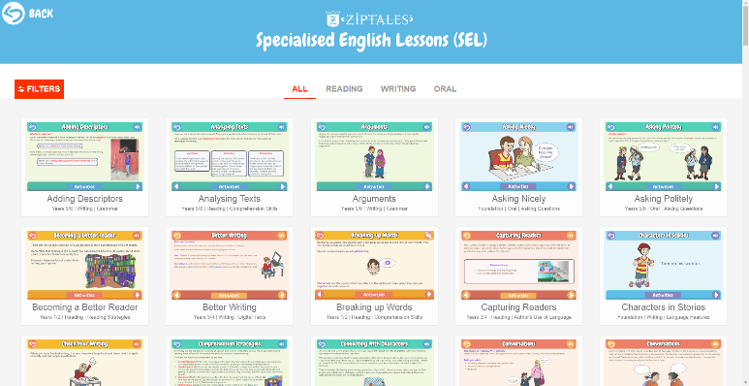
Use the following Specialised English Lessons Reading Modules to provide opportunities for students to develop their skimming and scanning skills:
Finding Facts and Graphic Organisers (Yrs 3 & 4)
Refining Research Skills and Mapping Information (Yrs 5 & 6)
Students working in the same reading group use the scanning technique to separately compose five questions about a focus text they have read. Collate the questions and use them to conduct a trivia quiz.

Slide 37
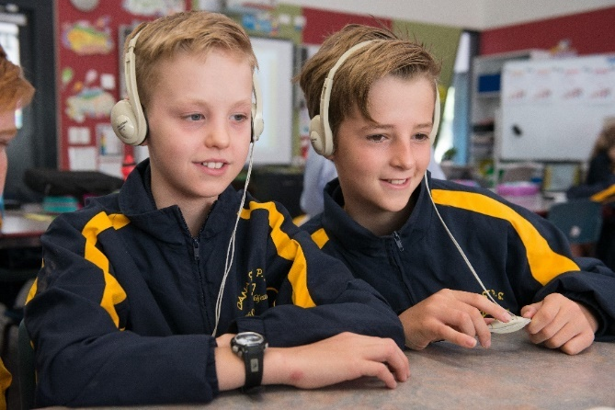
Conclusion
Equipping young readers with the tools they require to experience success in reading is important.
Providing opportunities for your students to use and implement the reading strategies presented in this webinar provides a solid foundation for them to develop into independent and effective readers.
Email: support@ziptales.com
Phone: 1800 004 442 (Aus) or 0800 141 480 (NZ)

