Slide 1
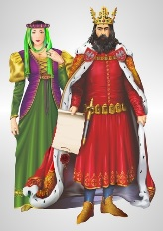
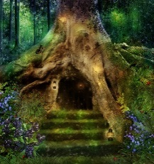
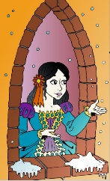
Teaching the Art of Narrative Writing Year levels: 3, 4, 5 & 6
Ziptales Webinar Number 3

Slide 2
The Importance of Narrative
Stories are central to people’s lives.
Children love narrative.
We need to teach children how to construct narratives.
But teaching how to structure a story can be difficult.

Slide 3
Narrative in the Australian Curriculum
The new Australian Curriculum mandates narrative. For example:
Discuss how authors make stories exciting, moving and absorbing and hold readers' interest by using various techniques…
character development and plot tension Create literary texts by developing storylines, characters and settings
The NAPLAN test includes, as an option, a narrative writing piece.
This seminar explores:
What is a story?
The problem situation
Character and motivation
What happens next …? The importance of plot
Is genre important?
A writer’s toolkit
Five ways to kill a story stone dead

Slide 4
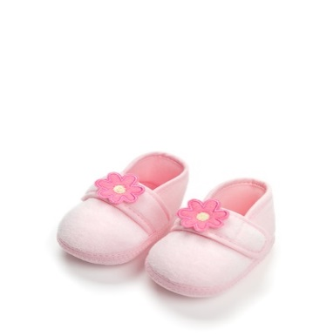
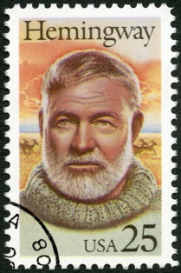
What is a story?
Ernest Hemingway’s six word story:
For sale: baby shoes, never worn.
More modern examples:
Crook outruns cops. Walkie-talkies outrun crook.
Penniless man. Won lotto. Overnight genius.
Man cries, holding his dog’s leash.

Slide 5
What is a story?
What is a story?
is not a story. It is just two events.
A modern equivalent:
I went to the office on Monday. I went on Tuesday.
I went on Wednesday. I went on Thursday. On Friday I was sick.
On Saturday I rested. On Sunday I felt better.
This too is not a story.
The king died and then the queen died.

Slide 6
What is a story?
However…
is a story.
There is a causal connection. The first event - the death of the king –
is the cause of the queen’s death.
There is an argument – a problem leading to some sort of development and finally to a resolution.
E.M.Forster Aspects of the Novel (1927)
The king died and then the queen died of grief.

Slide 7
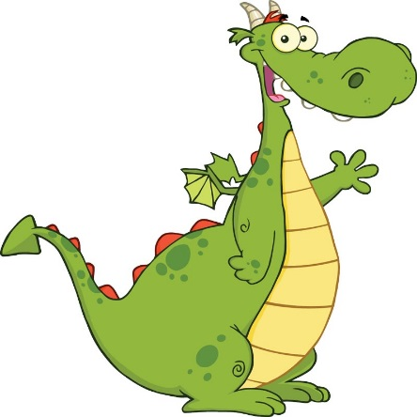
What is a story?
Here is a very short example from a child:
One day I found a very strange egg. I put the egg in my pocket and took it home. I kept it warm for twelve days. Finally it cracked and a green wing appeared, followed by a green tail, and lastly out popped… Oh no! A dragon…. (Toby Fotheringham)
Suggested activities
Take famous fairy tales and work out what happens that makes them stories.
“Make up a story” - create the outline of a story from simple words or ideas:
boy who sees into the future; girl who can’t lie, etc.
Try “What if…?” exercises: What if you could read people’s thoughts? What if a strange cousin came to live? What if you got lost in a strange city? etc

Slide 8
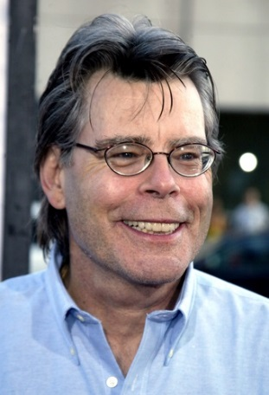
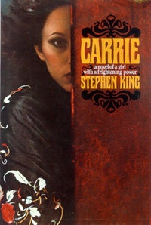
The problem situation: the seed of narrative
Stephen King:
“I find a ‘situation’ that is a problem – and develop it.”
Example:
A girl is tormented by school bullies. She has special powers. She revenges herself on her tormentors using her powers.
This is the basis of Carrie. It launched the then unknown US school teacher into a writing career spanning 40 years.

Slide 9
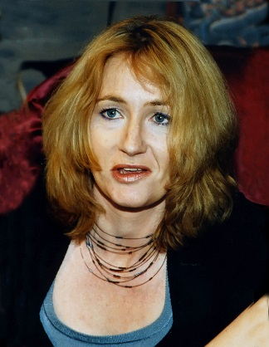
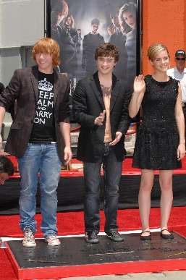
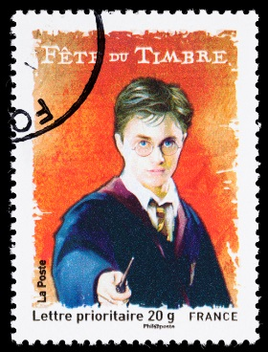
The problem situation: the seed of narrative
J K Rowling:
there is a boy wizard named Harry
he goes to school (Hogwarts)
he is the orphan son of wizards who had been killed off by Voldemort
Voldemort is coming after Harry Potter

Slide 10
What is the key to narrative?
“There is a problem, usually caused by some turmoil within the home. A woodsman marries a second wife who wants his children dead, a young girl’s father remarries and the new wife brings wicked stepsisters into her life, a mermaid falls in love with a prince…”
(Carolyn Wheat, How to write killer fiction)
The protagonist
(the central character)
is in personal jeopardy.
Examples:
Snow White finds
herself in the woods
with a man who has
been ordered to kill
her and cut out her heart.
James Bond has to avoid being killed in some very unpleasant way.
Sometimes it’s the whole world that is in jeopardy.
Danger and threat – whether physical or psychological – is essential to most stories.

Slide 11
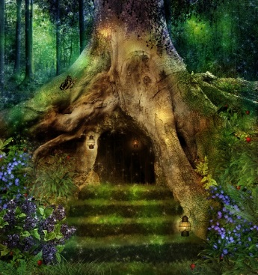
What is the key to narrative?
Sometimes the situation is a need or goal that must be satisfied. Example:
Kate finds a key in her Mum’s jewellery box. She tries all the doors in her house, but the key doesn’t fit. She goes to the garden. Behind a bush is a door. The key fits and she goes through into…
(Dione Mitchell)
Kate’s curiosity is the key ingredient. What does the key fit? She needs to know. That is her goal.

Slide 12
What is the key to narrative?
Other examples
“Wrong number,” says a familiar voice.
When he woke up, the dinosaur was still there.
Last man on Earth. There is a knock at the door.
Suggested activities
As a class, talk about the basic idea of famous films and stories.
Talk about odd situations eg Being locked out of the house; A stranger appears; You accept a stupid dare. Talk about how you could develop a story out of that situation.
Use these words as a starting point for a story: Revenge; Escape; Rescue; Temptation; Underdog; Lost.
If someone has a problem, or a goal to reach, they must act. This causes them to go on a narrative “journey” - the story.

Slide 13
Character and motivation
All stories have characters. Why?
Stories: how people act in response to a problem or goal.
Kate what is key for? Kate needs to find out
Kate’s motivation is curiosity.
Carrie bullied Wants revenge
Carrie’s motivation is pain.
Characters have goals.
Kate wants to find out (her goal)
Carrie wants revenge (her goal)

Slide 14
What is the key to narrative?
Characters should be like real people. Everything must be “true” to the character.
Kate is a sweet little girl.
Carrie is a troubled teenager.
Suggested activities
In groups, talk about what we would expect if these characters appeared in a story: The Prince in Cinderella; Shrek; Harry Potter.
Design a character (Part A). You might create a young boy who is always up for something dangerous to do; or a girl who is unhappy because she is lonely; or a fantasy character such as a fairy or a princess.
Design a character (Part B). Now take the character created (Part A) and imagine a problem situation, something that that character has to respond to.
The actions, the plot - must align with the character.
If Kate decided to take revenge?
If Carrie wanted to explore a fantasy garden?

Slide 15
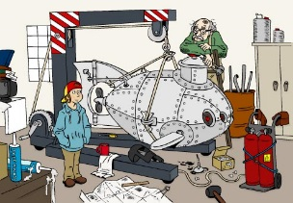
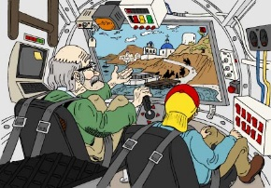
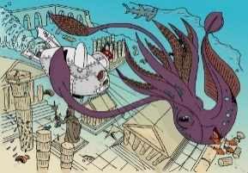
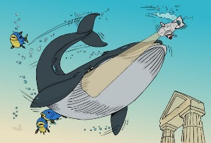
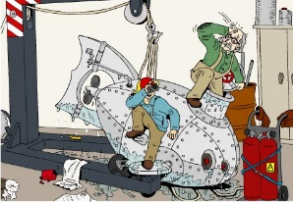
What happens next…? The importance of plot
A character reacts to the problem situation. Example:
Plot =
(1) Billy and Harry go to Santorini and dive
(2) they see Atlantis - this a wonderful thing, but
(3) a Kraken appears (it is a perilous situation)
(4) they escape in the machine, but
(5) a giant whale appears and endangers them, so
(6) they escape, but
(7) an earthquake begins, so
(8) they teleport back home - safe and sound.
Dr Wow in Atlantis
Characters = Billy, his crazy inventor Uncle Harry
Provocative situation = Harry invents a submarine to explore the lost city of Atlantis

Slide 16
Plot
Climax 3
Earthquake
Climax 2
Climax
Climax 1
Whale
Anticlimax
Kraken
Complication
Anticlimax
Anticlimax
Complication
Return home
Santorini
Complication
Lab
Beginning of action
Resolution
Exposition

Slide 17
What happens next…? The importance of plot
Authors deliberately create problems for their characters.
Climax 3
Climax 2
Climax
Climax 1
Anticlimax
Complication
Complication
Complication
Beginning of action
Exposition
Resolution

Slide 18
What happens next…? The importance of plot
Dione and the key to the mysterious door.
Climax 3
A wicked
wizard appears
The key is lost
Climax 2
The wizard is defeated with
the magic key
Climax
Climax 1
It is ruled by an evil witch
Anticlimax
Complication
Dione arrives in the magical land beyond the door
Complication
Dione goes home
Complication
Anticlimax
The key is found
Beginning of action
Dione defeats the witch
Exposition
Anticlimax
Resolution

Slide 19
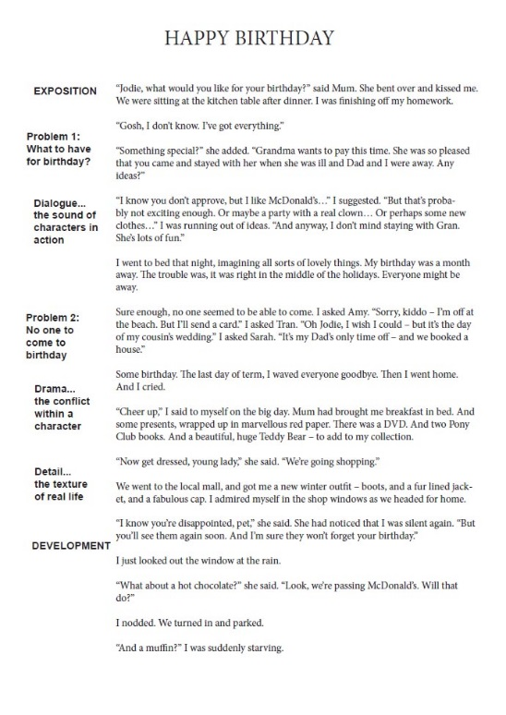
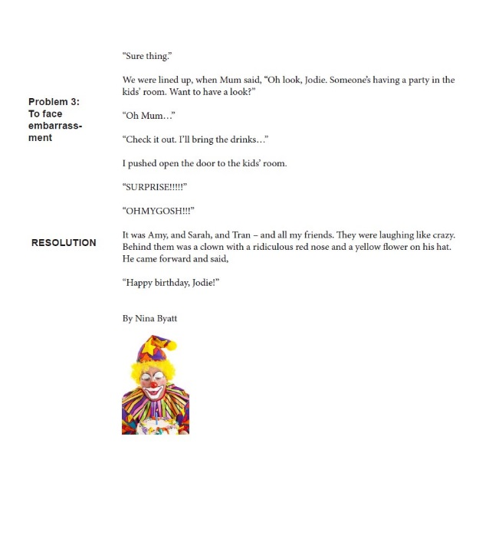
Stories are always structured
Even in intimate human interest, or emotional, stories, there is a definite shape to the narrative – problem, development, and finally resolution.

Slide 20
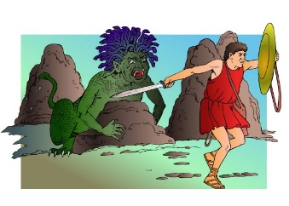
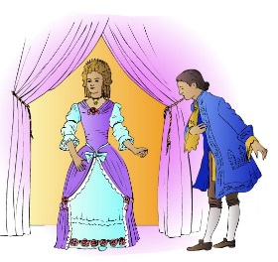
The seven basic plots
Christopher Booker claimed there were a total of just seven basic plots:
Overcoming the Monster
Hero learns of a great evil, and sets out to destroy it. Eg Perseus and Medusa, James Bond, Star Wars
Rags to Riches
Hero gains wealth and success. Eg Cinderella, Aladdin
The Quest
Hero learns of a magical object or wonderful place - and sets out to get there. Eg The Wizard of Oz, Lord of the Rings
Voyage and Return
Hero goes to a strange land and, after overcoming the threats, returns. Eg Alice in Wonderland, Peter Rabbit, The Time Machine
and so on.
(Christopher Booker, The Seven Basic Plots)
The other plots are: Comedy, Tragedy and Rebirth.

Slide 21
The twenty master plots
Ronald Tobias, in Twenty Master Plots:
1 Quest eg Raiders of the Lost Ark
2 Adventure eg Treasure Island
3 Pursuit eg The Fugitive
4 Rescue eg The Princess Bride, ET
5 Escape eg The Rats of NIMH
6 Revenge eg The Incredibles
7 The Riddle eg almost all whodunnits or mysteries
8 Rivalry eg Snow White and the Seven Dwarfs
9 Underdog eg Cinderella, Ratatouille
10 Temptation eg The Lion, the Witch and the Wardrobe
11 Metamorphosis eg Beauty and the Beast
12 Transformation eg My Fair Lady
13 Maturation eg Tom’s Midnight Garden
14 Love eg Tangled, Enchanted
15 Forbidden Love eg Romeo and Juliet
16 Sacrifice eg The Happy Prince
17 Discovery eg The Hobbit
18 Wretched Excess eg The Dark is Rising
19 Ascension eg Harry Potter
20 Descension eg Dracula
Suggested activities
Task 1: Make a selection from the two lists of story plots – choose 12 story plot types.
Then as a class or in groups find examples of each.
Task 2: (a) Find another example, and (b) write a simple outline of an original story using that plot type.
Find a Ziptales story and pull its plot to bits - as for “Dr Wow in Atlantis”.

Slide 22
Is genre important?
Children see that there are different types of stories. (Genre = French for type)
A fairy tale or fantasy has magical characters and lots of wonders.
A mystery story has clues and investigates possible suspects.
A comedy story has misunderstandings, confusion, embarrassing surprises etc.
A scary story has a terrifying threat of some kind.
An adventure story has lots of action and danger.
A myth has a hero on a dangerous quest.
A people or relationship story is about people resolving their issues satisfactorily.
Suggested activities
Source one story from Ziptales. (1) Read the story, and (2) strip it down to its basic lines. What makes it work? What other stories are like this? Then children create their own stories in each genre type.
Study popular films eg Frozen, Toy Story, etc – what genre (and why)?
Have children make up the plot line of a story in each major genre: one group creates a mystery story, one a scary story, one a fairy tale, etc.

Slide 23
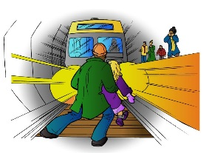
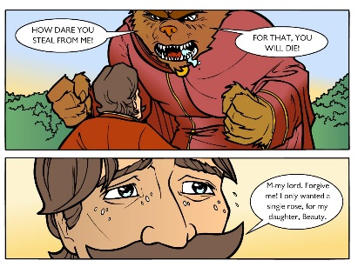
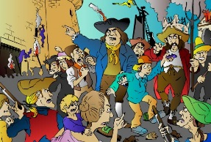
A writer’s toolkit
“Subway hero”
Drama - all stories thrive on conflict.
Dialogue - the words spoken by the characters
bring the situation to life. Dialogue is vital.
Detail - Detail brings a story to life.
“Beauty and
the Beast”
“Dr Wow”
Suggested activities
Imagine a situation at school where two people are in conflict over something. How could this give rise
to a story?
Take that situation, and work out what they could say.
Take a setting from the earlier activity on plot and build up all the details to make it come to life.

Slide 24
Five ways to kill a story stone dead
Don’t set boring topics eg “How I spent my summer holidays.”
Don’t say “Only write about what you know!” or “Only write about real life!” It’s more important to encourage children’s imagination.
Don’t say: just write whatever comes to mind.
Don’t say use lots of big words. Narrative writing is not linguistic “dress up”.
Don’t insist on a moral.
Suggested activities
Share with the children the stories you really liked as a child, and explain why.
Brainstorm great ideas for a story (in whatever genre) and let children fill in the details.
Encourage imagination and invention. Even if the story is not perfect, it’s extending them mentally.

Slide 25
Webinar 3
Thankyou for joining us for this online webinar on Teaching Narrative Writing.
This session represents 30 minutes of Professional Development.
A certificate will be emailed to you following the successful completion of the session.
We wish you and your students all the very best for all their narrative writing!

